Slide 1
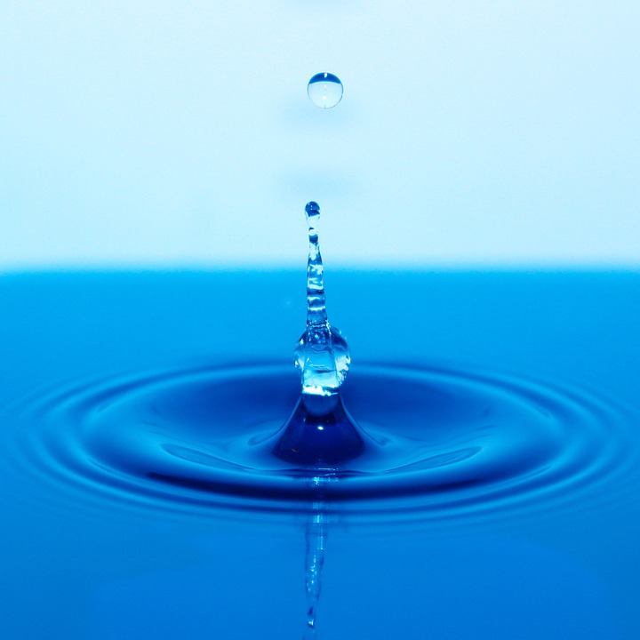
Save water

Slide 2
WARM UP
1) BRAINSTORMING: IN OUR DAILY ACTIVITIES, WHAT DO WE USE WATER FOR?
WE USE WATER TO:
- BRUSH/CLEAN OUR TEETH
- WASH OUR FACE
- HAVE A SHOWER/HAVE A BATH
- FLUSH THE TOILET
- DRINK
- COOK
- WASH THE DISHES
- WASH OUR CLOTHES
- CLEAN THE HOUSE
- WATER THE GARDEN
- WASH THE CAR
THE STUDENTS MAKE A POSTER TO REPRESENT THE DIFFERENT USES OF WATER IN EVERYDAY ACTIVITIES (group work)

Slide 3
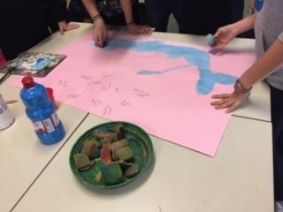
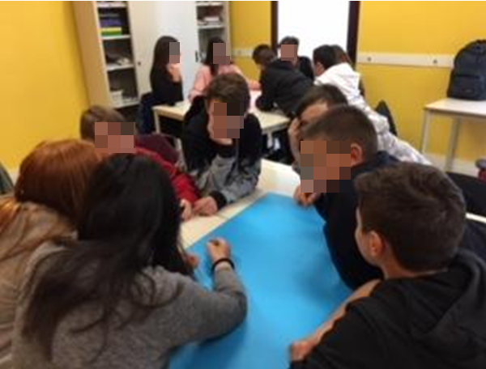

Slide 4
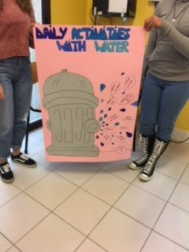
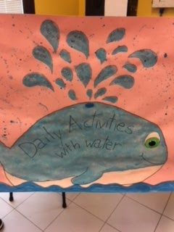
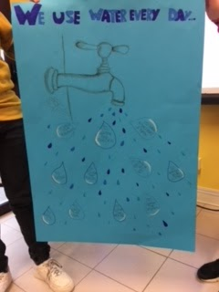

Slide 5
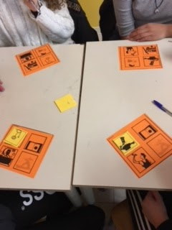
2) TO PRACTISE THE VOCABULARY LEARNT, STUDENTS PLAY A GAME: DAILY ACTIVITIES WITH WATER BINGO

Slide 6
3) WATER CONSUMPTION: HOW MUCH WATER DO WE USE IN OUR DAILY ACTIVITIES?
STUDENTS ANSWER A QUIZ ABOUT WATER CONSUMPTION IN DAILY ACTIVITIES.

Slide 7
4) WATER DIARY: THE STUDENTS FILL IN A WEEKLY DIARY WHERE THEY MARK THEIR WATER CONSUMPTION.

Slide 8
MY WATER DIARY
Activity | Flushing toilet | Drinking water | Washing machine | Hand washing dishes | Dishwasher | Washing | Shower | Bath | Brushing teeth | Washing the car
Amount used | 6 litres per flush | O,5 litre per drink | 50 litres | 12 litres | 14 litres | 6 litres | 40 litres (5 minutes) | 80 litres | 6 litres | 35 litres per bucket
Monday
Tuesday
Wednesday
Thursday
Friday
Saturday
Sunday

Slide 9
LEARNING BY DOING
THE STUDENTS REFLECT ON THE RESULTS OF THEIR DIARIES
THEY COMPARE THEIR DATA WITH THOSE OF THE LINK www.focus.it/ambiente/ecologia/quanti-litri-di-acqua-al-giorno-ci-servono
STUDENTS WATCH A VIDEO https://youtu.be/iRGZOCaD9sQ

Slide 10
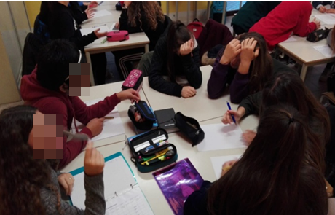
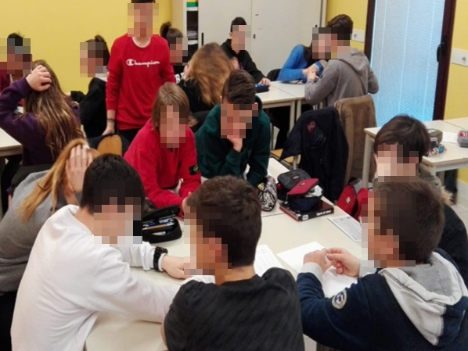
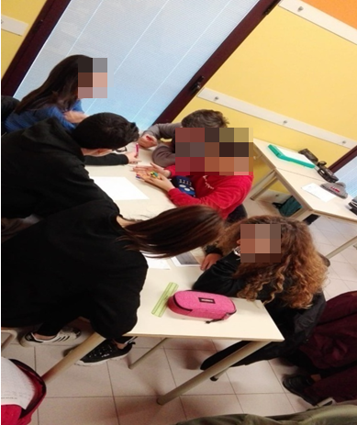
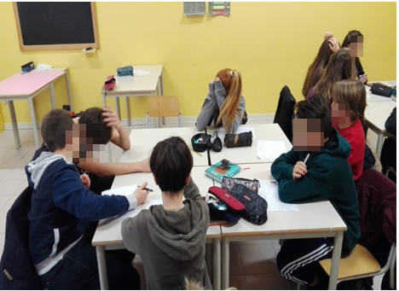
4. STUDENTS CREATE A POSTER WITH TIPS TO SAVE WATER

Slide 11
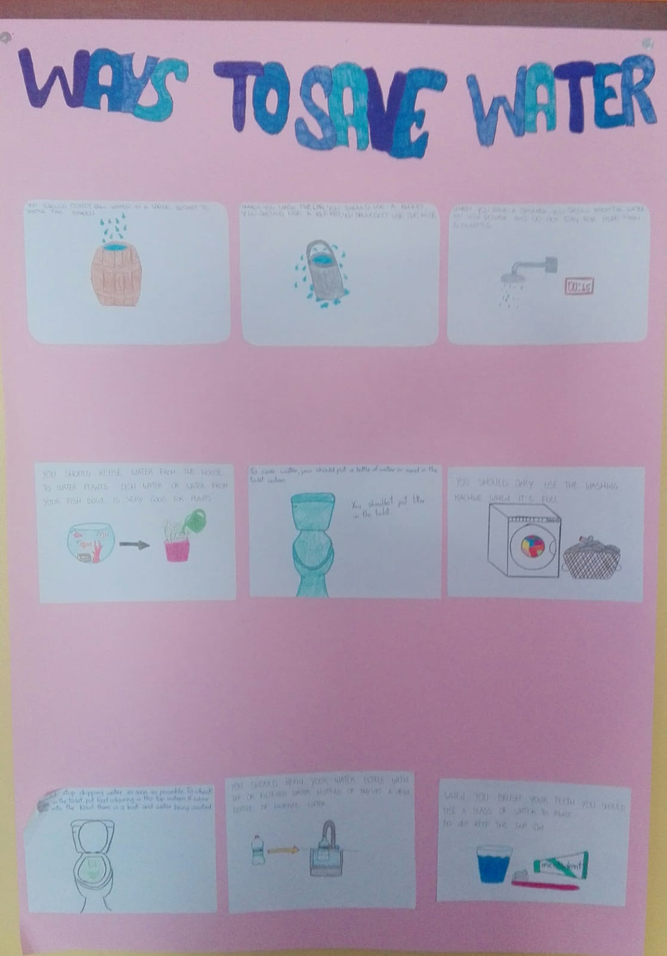

Slide 12
5. DEBATE BOTTLED VS TAP WATER
6. VIDEO ON PLASTIC IN THE OCEAN
https://www.youtube.com/watch?v=ju_2NuK5O-E
7. REFLECTIONS

Slide 13
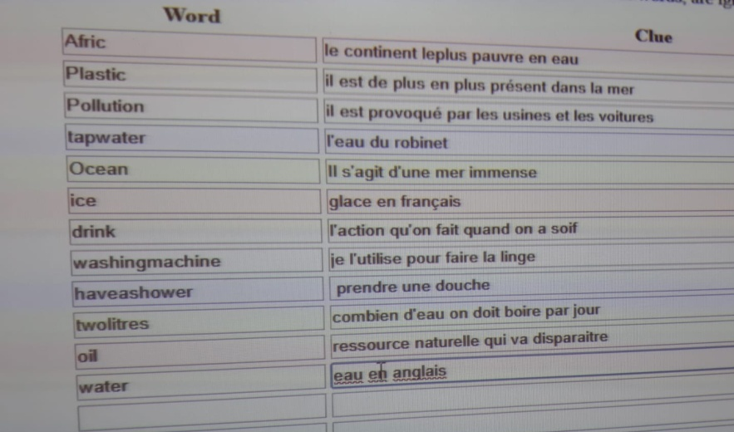
LEARNING BY PLAYING
8. CROSSWORD PUZZLE CREATED BY STUDENTS WITH KEYWORDS OF THE ACTIVITY (the definitions are in French and the words are in English)

Slide 14
FINAL PRODUCT
The students make a promo video that is shown to the other classes of the school on the twenty-first March .Together with the video, they also play a game with the classes: a quiz with multiple choice answers about green habits. The students who answer correctly will receive a gadget on the twenty-second March, International Water Day. On this day, all the school is invited to wear a light blue T-shirt.

Slide 15
