Slide 1
Clil First Lesson

Slide 2
PLANNING Understanding how much time you want to spend on a topic is as important as knowing the topic you are going to talk about. Pianificare il tempo a disposizione è di fondamentale importanza. Every activity needs to respect the timing you have decided as much as you can Ogni attività deve cercare di rispettare le tempistiche decise dal docente il più possibile.

Slide 3
Choose a subject, and then a topic
You can decide to choose a specific subject and focus on it, or you can prefer to choose two or more subjects and then find a topic that can link them.
Non necessariamente si deve focalizzare l’attenzione su una materia singola, può anche essere che si lavori su un piano interdisciplinare: sceglienDo più materie collegabili rispetto ad un argomento specifico.

Slide 4
Today’s subjects: Geography-science
Topic: The World of Animals
*start with a question
*STart with a brainstorming
*Start with an interactive game or activity
*start with a video or some pictures

Slide 5
Today’s subjects: Geography-science
Getting started
1)What do you know about animals?
2)Is there any difference between a pet and an animal?
3)How can you categorize animals?

Slide 6
Getting started
BRAINSTORMING1
CAN SWIM
WITH A TAIL
WITH WINGS
CAN FLY
WITH FINS
ANIMALS
EAT MEAT AND PLANTS
WITH FUR
EAT PLANTS
CAN WALK
CAN JUMP
EAT MEAT

Slide 7
Getting started
BRAINSTORMING2
BIRDS
MAMMALS
REPTILES
WILD ANIMALS
VERTEBRATES
ANIMALS
PETS
INVERTEBRATES
SEA ANIMALS
FISH
CARNIVORE
HERBIVORE
HOMNIVORE
INSECTS

Slide 8
The miming game
Miming an animal it can be a good point of start for the very little kids.
They can try to imitate an animal or An entire sentencE/action without saying a word.
It can help them to be more confident and try to guess the animal.
https://www.youtube.com/watch?v=I9-gMJr1TQE

Slide 9
Guess what
This game can be another good start: you can describe an animal giving the class just few information:
-habitat
-colour
-diet
-what it can do
«i’m the tallest living terrestrial animal,I eat plants and I naturally live in a very hot place, who am i? »

Slide 10
Start with a song or a video
https://www.youtube.com/watch?v=_Ir0Mc6Qilo
A song can help you introduce a topic, or even a grammar focus:
In this example it can be both things.
Your grammar focus is going to be the use of «can for ability»

Slide 11
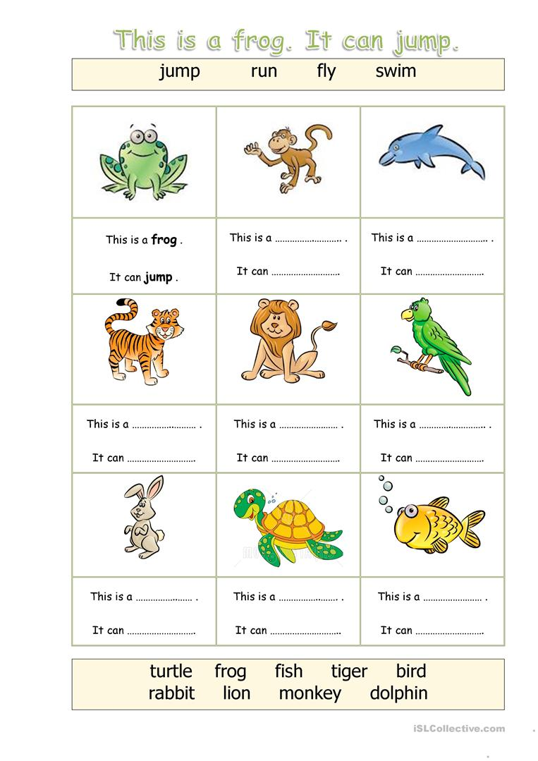

Slide 12
Explaining a grammar focus
Try to example in the most simple way possible.
Give them lots of examples.
Make them enjoy the activities and involve them.
Play with them:they can try to be the teacher and give the class some examples

Slide 13
Can for ability
Can is used to express ability:
-I can play the guitar
-i can read a book
-I can cook a cake
Try to do it with animals.
Divide the class in little groups and let them work together: you can give them the name of an animal and they should write 4 sentences with can or can’t

Slide 14
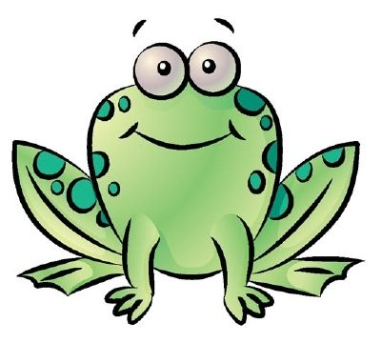
Can for ability
A Frog
It can jump
It can’t fly
It can swim
It can’t run
A

Slide 15
Can for ability
What can you do?
Can you swim?
What can’t you do?
Can you tell me your favourite animal?

Slide 16
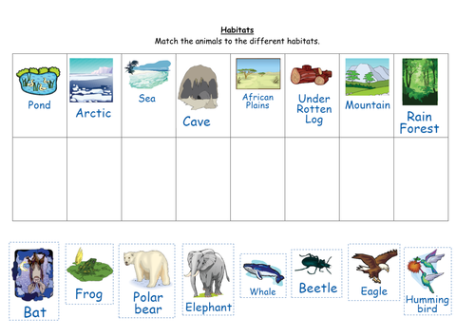
Habitats
Where do different animals live?

Slide 17
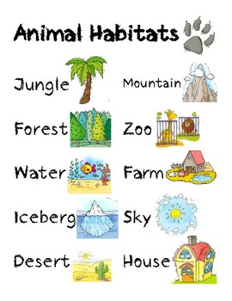
Where do different animals live?
WHERE DO YOU LIVE?
Can you describe these habitats?
https://kids.nationalgeographic.com/explore/nature/habitats/
https://kids.nationalgeographic.com/animals/
Some websites can help you showing the kids different habitats and the animals that live there

Slide 18
Where do different animals live?
USE OF ADJECTIVES TO DESCRIBE DIFFERENT HABITATS
HOT
DRY
FLAT
COLD
HUMID
TINY
ALPINE/
MOUNTAIN

Slide 19
Now it’s your turn!
Divide your class into little groups
Work together and fullfill the «Lesson Plan Worksheet» based on this Geography/Science Activity
Think about new activities or games
Let’s do a brainstorm!
Share your new ideas with the class

